Slide 1
Projekta aizstāvēšana
Rinats Andrejevs
Kaspars Cīrulis
Artemijs Drinkmanis
Oskars Kuzņecovs
12.6

Slide 2
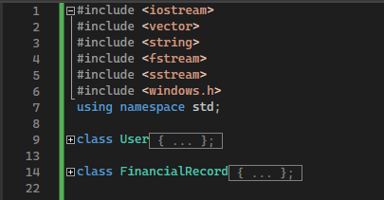
Bibliotekas

Slide 3
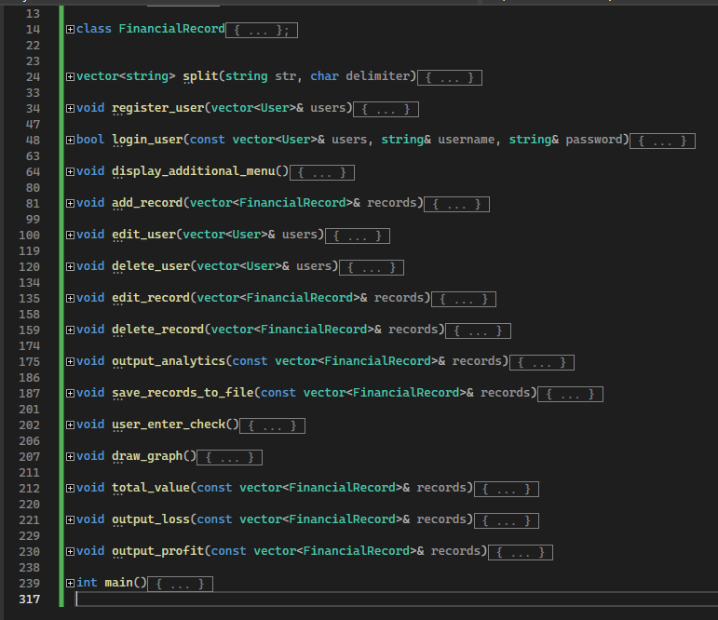
Funkcijas

Slide 4
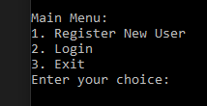
Main Menu

Slide 5
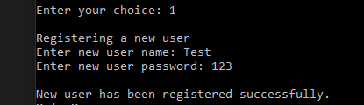
Register new User

Slide 6
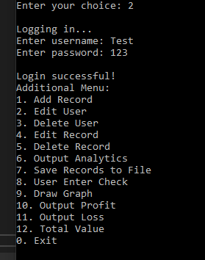
Additional Menu

Slide 7
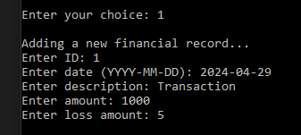
New Financial Record

Slide 8
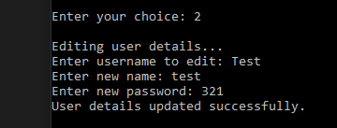
user details

Slide 9
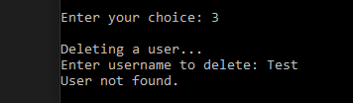

User deleting

Slide 10
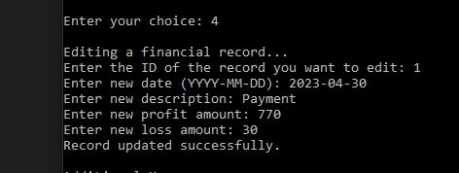
Data input for record

Slide 11


Delete record
Data validation

Slide 12
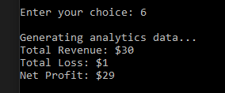

Output analytics
Save records to file

Slide 13




Total profit
Total loss
Text file
Total value

Slide 14
Paldies par uzmanību

